Slide 1

Spring, 2022
AI6315
Introduction to self-driving cars
5. CAN(Controller Area Network)
Prof. Yong-Gu Lee
Notes:
오늘은 CAN에 대해서 학습합니다.

Slide 2
 | Course Instructor
 |  | Prof. Yong-Gu Lee | Office. Mecha. Bldg. Rm. 210 Tel. 062-715-2396 Email. lygu@gist.ac.kr
 | Teaching Assistant
 |  | Inwoo Hwang 황인우 | Office. Mecha. Bldg. Rm. 225 Tel. 062-715-3267 Email. hwanginwoo@gm.gist.ac.kr
 | Classroom & Class Hours
 |  | Online & AI Grad School Rm. TBD 16:00-17:15 every Monday and Wednesday
Notes:
이번에는 이성재 조교가 실습을 진행하지 않습니다!
This time, Assistant Lee sung-jae will not conduct the practice!
질문사항이 있으면 황인우 조교에게 메일주세요!
If you have any questions, please send an email to TA Hwang In-woo!

Slide 3
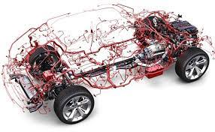
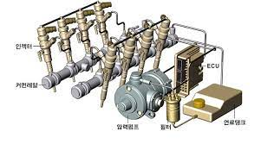
1. CAN
CAN(Controller Area Network, CAN)
Developed for automotive electronics by BOSCH of Germany, application expanded to various industrial devices as well as automobiles.
Low cost, robust against noise, and automatic bus disconnection of nodes that are physically defective.
Data messages do not contain source or destination addresses, only identifiers related to priority.
Harness
Common Rail Direct system
Notes:
CAN은 독일의 보쉬사에서 개발되어서 자동차 뿐만이 아니라 여러 분야에서 사용되고 있습니다. CAN was developed by Bosch in Germany and is used in many fields as well as automobiles.
독일의 보쉬사는 실린더에 직접 연료를 분사하는 커먼레일 시스템을 개발한것으로 또한 유명합니다. Bosch is also famous for developing a common rail system that injects fuel directly into cylinders.
복잡한 와이어링 하네스를 사용하지 않아 비용이 적고, 노이즈에 강인하며 물리적으로 취약한 노드를 스스로 절단할 수 있습니다. Cost is low due to the lack of complex wiring harnesses. In addition, noise-resistant, physically vulnerable nodes can be cut by themselves.

Slide 4
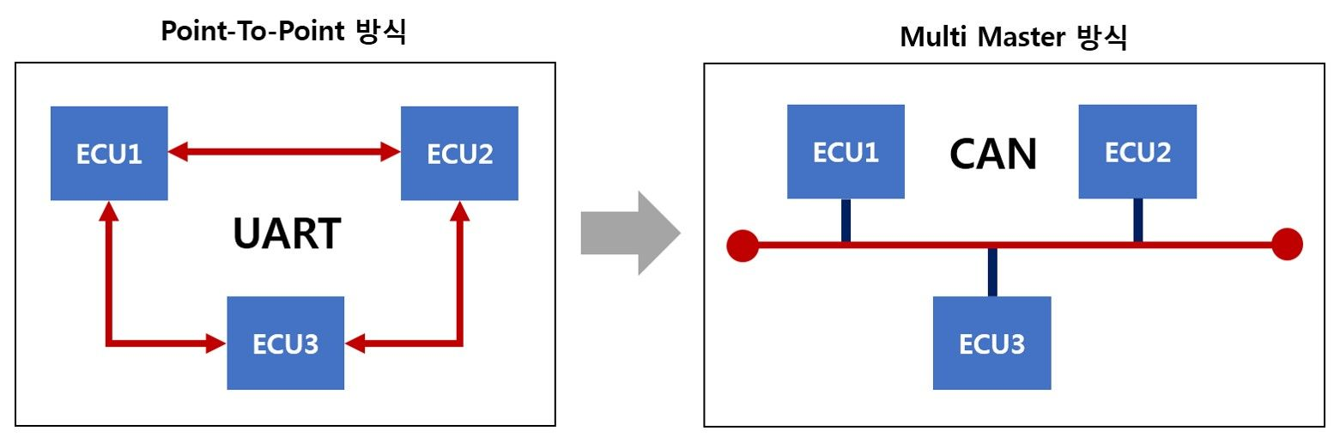
1. CAN
In the early days, there were not many modules in the car, so the ECU was connected in a point-to-point.
This method requires many lines for communication between different modules.
CAN solves this problem with the multi-master structure. Multi-master architecture does not have analog and digital inputs for each device, but only a single CAN interface.
Bus
ECU : Electronic Controller Unit
Notes:
CAN은 많은 모듈간 통신상에서 불리한 Point to Point방식을 쓰는 것이 아니라, 단일의 CAN bus를 갖는 Multi-maste방식을 사용합니다. CAN uses a multi-master method with a single CAN bus instead of using a point to point method that is disadvantageous in many module communication.

Slide 5
2. CAN Network
The CAN network includes several CAN nodes (ECUs performing tasks in the CAN network are called CAN nodes) that are connected by a transmission medium (CAN bus).
Physically, a twisted pair of wires is used to carry the signal. By using this method, noise generated from the CAN bus can be reduced. The two wires are separated by CAN_H CAN_L.
The maximum data rate is 1 Mbit/s, and the network can be extended up to 40 meters. The maximum number of CAN nodes is defined as 32.
Since the signal transmission speed is limited, a reflection occurs as the data speed increases and the bus expands.(A phenomenon in which the signal from the signal source is reflected back to the signal source. This reflected signal can cause distortion or oscillation of the signal.) Therefore, the end of the communication channel is blocked through the blocking register(gererally 120Ohm), the reflection can be prevented in the high speed CAN network.
CAN node
CAN node
CAN node
CANH
Resister
Resister
CANL
ECU : Electronic Controller Unit
Notes:
캔 네트워크는 수많은 캔 노드를 포함합니다. 여기서 캔노드는 ECU를 뜻합니다.
The CAN network contains numerous CAN nodes. CAN node means ECU.
그리고 2개의 꼬인 선이 물리적으로 신호를 전달하기 위해 사용됩니다. 이렇게 꼬인 선의 구조는 신호 전달에서 발생하는 노이즈를 줄여줍니다. 이 2개의 선들은 각각 CAN-high, CAN-low로 불립니다.
And two twisted wires are used to physically carry the signal. This twisted-wire structure reduces noise from signal transmission. These two lines are called CAN-high and CAN-low
신호 전달 속도가 제한되어 있기 때문에 데이터 속도가 증가하고 버스가 확장되면서 반사현상이 발생하기도 합니다.
Since the signal transmission speed is limited, a reflection occurs as the data speed increases and the bus expands
반사현상이란 source에서 나온 신호가 다시 source로 되돌아오는 현상으로, 신호의 왜곡이나 떨림을 발생시킵니다.
reflection means a phenomenon in which the signal from the signal source is reflected back to the signal source. This reflected signal can cause distortion or oscillation of the signal
따라서 양 끝단 부분에 종단저항을 설치하여서 반사 현상을 방지합니다.
Therefore, terminating resistors are installed at both ends to prevent reflection.

Slide 6
3. CAN Controller
In order for the ECU to participate in CAN communication, a CAN interface is required. It consists of a CAN controller and a CAN transceiver. The CAN controller performs the communication function required by CAN PROTOCOL.
The CAN transceiver connects the CAN controller to the physical transmission medium.
In CAN network, a CAN node has a difference according to the number of CAN messages it receives or transmits. A large difference may occur even in the reception or transmission frequency. (EX. one CAN node receives 5 CAN messages in a period of 10ms, but the other node receives one message in a period of 100ms.)
The can controller can be integrated into or separated from the MCU (Microcontroller). In the case of integration, less space is required, but in the case of separation, communication between CAN controllers is faster and safer.
CAN node
Transceiver
Controller
Microcontroller
HOST
Stand Alone CAN Controller
Controller
Transceiver
Microcontroller
Transceiver
Integrated CAN Controller
(MCU에 Controller 내장)
CANH
Microcontroller
CANL
Single-Chip CAN Controller
(MCU에 Controller Transceiver가 모두 내장)
Notes:
각 ECU가 캔 통신에 참여하기 위해서는, 그에맞는 인터페이스가 요구됩니다. 이것은 캔 컨트롤러와 캔 트랜시버로 이루어져 있습니다. 캔 컨트롤러는 캔 프로토콜에서 필요한 통신 기능을 수행합니다.
In order for the ECU to participate in CAN communication, a CAN interface is required. It consists of a CAN controller and a CAN transceiver. The CAN controller performs the communication function required by CAN PROTOCOL.
캔 트랜시버는 직접적으로 캔 버스와 연결되는 CAN_H와 CAN_L 로 구성되어있습니다.
The CAN transceiver consists of CAN_H and CAN_L directly connected to the CAN bus.
CAN 네트워크에서 CAN 노드는 수신 또는 전송되는 CAN 메시지 수에 따라 차이가 있습니다. 수신 또는 송신 주파수에서도 큰 차이가 발생할 수 있습니다. In CAN network, a CAN node has a difference according to the number of CAN messages it receives or transmits. A large difference may occur even in the reception or transmission frequency.
상기 캔 컨트롤러는 MCU(Micro Controller)에 통합되거나 분리될 수 있습니다. 통합의 경우 필요한 공간이 적지만 분리의 경우 CAN 컨트롤러 간 통신이 더 빠르고 안전하다.
The can controller can be integrated into or separated from the MCU (Microcontroller). In the case of integration, less space is required, but in the case of separation, communication between CAN controllers is faster and safer.
Stand alone CAN controller는 MCU, 트랜시버, 컨트롤러가 각각 분리되어 있습니다.
Stand alone CAN controller, the structure of the transceiver, the controller, and the MCU are all seperated.
Integrated CAN 컨트롤러는 MCU안에 컨트롤러가 내장되어 있습니다. The Integrated CAN controller has a controller built into the MCU.
Single-chip 컨트롤러는 트랜시버와 컨트롤러가 MCU에 내장되어 있습니다.
The single-chip controller has both a transceiver and a controller built into the MCU.

Slide 7
4. CAN transceiver
For connection with CAN bus
The CAN transceiver has two bus pins. One is CAN high and the other is CAN low. this is because physical signal transmission in a CAN network is symmetrical to achieve electromagnetic compatibility, and the physical transmission medium in a Can network consists of two lines.
High-speed CAN transceivers support data rates up to 1 Mbit/s, while low-speed CAN transceivers only support 125 kbit/s. However, low-speed CAN transceivers include a feature that prevents failure of the bus interface (if one of the two lines fails, the entire communication is maintained).
CAN node
Transceiver
Controller
Microcontroller
HOST
Stand Alone CAN Controller
Controller
Transceiver
Microcontroller
Transceiver
Integrated CAN Controller
(MCU에 Controller 내장)
CANH
Microcontroller
CANL
Single-Chip CAN Controller
(MCU에 Controller Transceiver가 모두 내장)
Notes:
CAN 트랜시버에는 버스 핀이 두 개 있습니다. 하나는 CAN High이고 다른 하나는 CAN Low입니다. 이는 CAN 네트워크에서 물리적 신호 전송은 전자기 호환성을 달성하기 위해 대칭적이며, CAN 네트워크에서 물리적 전송 매체는 두 개의 라인으로 구성되기 때문이다. The CAN transceiver has two bus pins. One is CAN high and the other is CAN low. this is because physical signal transmission in a CAN network is symmetrical to achieve electromagnetic compatibility, and the physical transmission medium in a Can network consists of two lines.
고속 CAN 트랜시버는 최대 1Mbit/s의 데이터 속도를 지원하는 반면 저속 CAN 트랜시버는 125kbit/s만 지원합니다. 그러나 저속 CAN 송수신기에는 버스 인터페이스의 장애를 방지하는 기능이 포함되어 있습니다(두 라인 중 하나가 고장 나면 전체 통신이 유지됩니다). High-speed CAN transceivers support data rates up to 1 Mbit/s, while low-speed CAN transceivers only support 125 kbit/s. However, low-speed CAN transceivers include a feature that prevents failure of the bus interface (it means if one of the two lines fails, the entire communication is maintained).

Slide 8
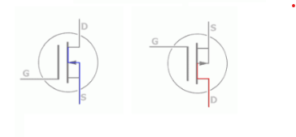
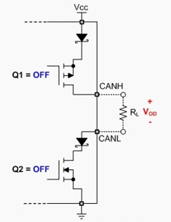
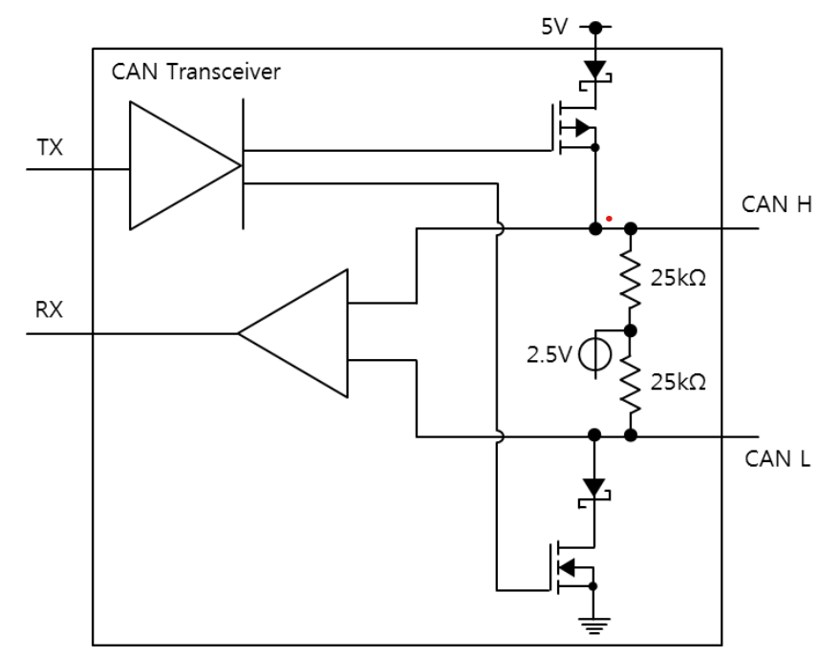
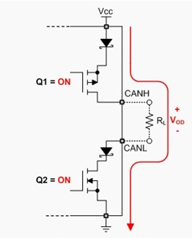
FET is transistor that act as switching in this circuit.
Recessive Bit : Bit that can be ignored for dominant bit
Dominant bit : bit that appears in preference to the bus
V_od = 0V
(CANH and CANL same Volt)
FET(TR)_1
V_cc
CAN H
Recessive State (TX = HIGH)
V_cc
1
Recessive
1
Recessive
GND
CAN L
FET(TR)_2
0
Dominant
V_od = V_cc
(CANH = V_cc, CANL=GND)
Dominant State (TX = LOW)
Notes:
여러분도 아시다시피 FET는 Field effect transistor를 뜻합니다.
As you know, FET stands for Field effect transistor.
트랜지스터는 일반적으로 전압 증폭 작용과 스위칭 역할을 합니다. Transistors typically act as voltage amplification and switching.
여기서는 트랜지스터가 스위칭 역할을 하기 위해서 사용됩니다. Here, the transistor is used to act as a switching.
FET는 Gain, Source Drain이라는 요소를 가지고 있는데, Gain에 문턱전압 이상의 전압을 주게 되면 Source와 Drain에 전류가 흐르게 됩니다. 이를 이용하여서 Switching 역할을 할 수 있습니다. The FET has an element called Gain, Source, and Drain, which causes current to flow through the Source and Drain when the Gain is given a voltage above the threshold voltage. This can be used to act as switching.
Recessive State에서는 FET가 비활성화 되어 있습니다. 그래서 CAN_H와 CAN_L가 같은 전압을 가지고 있습니다. 그래서 CAN_H와 CAN_L의 전압 차이는 0V입니다. FET is disabled in the Recessive State. So CAN_H and CAN_L have the same voltage. So the voltage difference between CAN_H and CAN_L is 0V.
Dominant State에서는 FET가 활성화 되어있습니다. 그래서 CAN_H가 V(cc)를 띄고, CAN_L는 GND를 띕니다. 그래서 CAN_H와 CAN_L의 전압 차이는 V(cc)를 띄게 됩니다.
FET is enabled in Dominant State. So CAN_H stands for V(cc), CAN_L stands for GND. So the voltage difference between CAN_H and CAN_L is V(cc).
이러한 방식으로 캔 트랜시버는 우성과 열성 신호를 내보내게 됩니다.
In this way, the can transceiver sends out dominant and recessive signals.

Slide 9
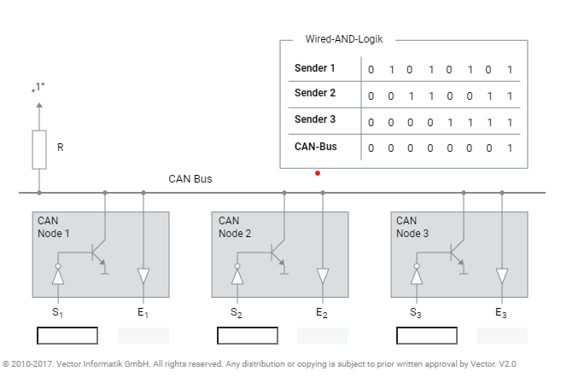
5. CAN bus logic
Physical signal transmission in CAN networks is based on differential voltage transmission (can H, can L).
A basic prerequisite for smooth communication is that the dominant and recessive buses must be clearly distinguished. The dominant bus level has a logic value of 0, and the recessive bus level has a logic value of 1.
dominant bus level overwrites all recessive bus levels.
recessive bus level occurs when all other can nodes transmit a recessive level.
Notes:
CAN 네트워크에서 물리적 신호 전송은 차동 전압을 기반으로 합니다.
In the CAN network, physical signal transmission is based on differential voltage.
원활한 소통을 위해서는 우성 신호와 열성 신호가 명백하게 구분되어야 합니다. 우성 버스는 값이 0이고, 열성 버스는 값이 1입니다. For smooth communication, the dominant signal and the recessive signal must be clearly distinguished. The dominant bus has a value of 0 and the recessive bus has a value of 1.
우성 신호는 모든 열성 신호를 무시할 수 있습니다.
dominant bus level overwrites all recessive bus levels.
열성 신호는 모든 신호가 열성일때 전달될 수 있습니다.
recessive bus level occurs when all other can nodes transmit a recessive level.

Slide 10
6. Communication
Each CAN node has the authority to send CAN messages to the bus of the CAN network. Sending messages is based on events rather than following a time sequence.
In response to an event, the host of CAN node A writes the relevant data as well as the associated ID = 0x15 into the TX buffer.
the can controller of node a sends the buffer as soon as the can bus is available.
CAN node
A
CAN node
C
ID 0x15
CAN BUS
CAN node
B
CAN node
D
Notes:
각각의 CAN node들은 메시지를 시간 순서에 관계 없이 다른 모든 노드들에게 보낼 수 있습니다. Each CAN node can send a message to all other nodes regardless of the time sequence.
만약에 CAN 노드 A가 ID가 0x15인 메시지를 보낸다고 하면, 이 메시지는 Tx buffer에 씌여집니다. If CAN node A sends a message with ID 0x15, this message is written to Tx buffer.
CAN 컨트롤러는 캔 버스가 가능한 상태에 있으면 이 메시지를 보낼 준비를 합니다. The CAN controller prepares to send this message when the can bus is available.

Slide 11
CAN nodes B, C, and D receive the corresponding data frame. The CAN controller of each node checks whether the received data is appropriate.(Every node receives every message and decides for itself whether to use it or not.)
CAN node
A
CAN node
C
ID 0x15
CAN BUS
CAN node
B
ID 0x15
CAN node
D
ID 0x15
Notes:
캔 노드 B,C,D가 해당 데이터를 받게 됩니다. 각 노드의 캔 컨트롤러는 이 데이터가 적합한지 판단합니다. Can nodes B, C, and D will receive the data. The can controller on each node determines whether this data is appropriate.

Slide 12
Can Node B accepts the data, and nodes C and D reject the data.
CAN Node B reads the data through the RX buffer.
CAN node
A
CAN node
C
ID 0x15
CAN BUS
CAN node
B
CAN node
D
Notes:
CAN Node B accepts the data, and nodes C and D reject the data.
CAN Node B reads the data through the RX buffer.

Slide 13
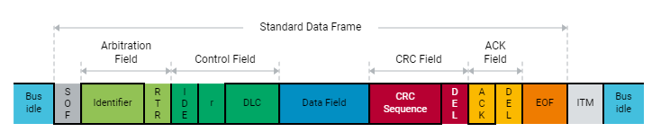
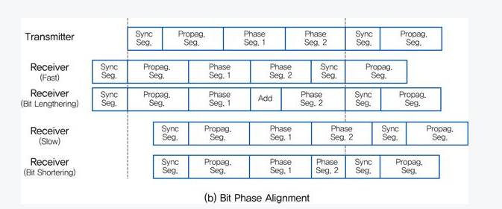
7. Data Frame
When transmitting user data, a method called data frame is used. A data frame can carry 8 bytes.
SOF: Compares all recessive-dominant signal edges with preset bit timing. If not, resynchronize. By this signal, all nodes must be synchronized and ready to respond.
1bit
11bit
1bit
1bit
1bit
4bit
0~8byte
15bit
1bit
1bit
1bit
7bit
3bit
V_cc
CAN H
Signaling Edge
V_cc
1
Recessive
1
Recessive
GND
CAN L
0
Dominant
Notes:
데이터를 전송할때 데이터 프레임이라는 방법을 사용합니다. 데이터는 8개의 바이트를 전달할 수 있습니다. 이 부분은 Data field 영역입니다.
When transferring data, a method called data frame is used. Data can carry 8 bytes. This is the Data field area.
데이터 프레임은 보시다시피 여러가지 요소가 있습니다. 지금부터 이 각각의 요소에 대해서 설명드리도록 하겠습니다.
As you can see, there are many elements of the data frame. Now I'm going to talk about each of these elements.
can BUS가 idle 상태가 되면 맨 처음 SOF영역이 있습니다. SOF는 모든 캔 노드들을 동기화 합니다. 모든 캔 노드가 Singaling edge라고 불리는 우성 상태에서 열성 상태로 가는 타이밍이 맞아야 합니다.
When the can BUS is in the idle state, the first area is SOF. it checked all CAN node is synchronized. All can nodes must be timed to go from dominant to recessive, called Singaling edges. 이게 모두 맞으면 모든 노드가 동기화 되어있으며, 데이터를 받을 준비가 되었음을 뜻합니다. If all of these are correct, it means that all nodes are synchronized and ready to receive data.

Slide 14
1bit
11bit
1bit
1bit
1bit
4bit
0~8byte
15bit
1bit
1bit
1bit
7bit
3bit
Identifier : Priority of data frame
RTR : It is used to inform the receiver of the frame type. Dominant means Data frame, recessive means Remote frame (frame used to request data from CAN node)
EOF : When this process is finished, the data frame transmission process is terminated by 7 recessive bits.
ITM : 3 bits required for the next message to come (recessive value)
Notes:
ID : 데이터의 우선순위를 결정합니다. 이 값이 낮을 수록 우선순위가 높습니다.
ID : Determines the priority of the data. The lower value has higher the priority.
RTR : 우성은 Data frame 열성은 remote Frame을 의미합니다. remote frame은 다른 노드에 데이터를 요구할때 쓰는 frame이며 많이 쓰이지는 않습니다.
RTR: Dominant signal means Data frame recessive signal means remote frame. A remote frame is a frame that is used to request data from other nodes and is not used much.
EOF : 프로세스가 끝날때, 데이터 프레임은 열성신호를 7번 보내게 됩니다. EOF: At the end of the process, the data frame sends a recessive signal seven times.
ITM : 다음 메시지가 오는것을 알리기 위해서 3개의 열성 신호가 필요합니다.
ITM: Can bus needs three recessive signals to signal the next message.

Slide 15
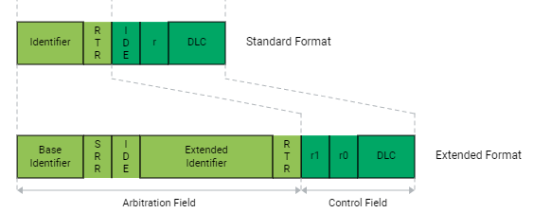
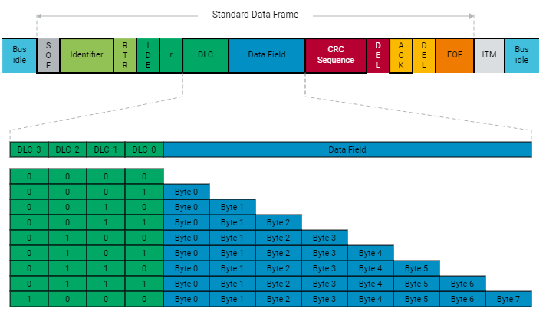
IDE : Used to distinguish between standard and extended formats. (Dominance is standard format, recessive format is extended format)
DLC : Determine the length of the data field.
CAN2.0a
11bit
1bit
1bit
1bit
4bit
CAN2.0b
1bit
1bit
1bit
1bit
4bit
11bit
1bit
18bit
Notes:
IDE는 확장 ID를 사용할지 기본 ID를 사용할지 결정합니다. IDE determines whether to use the extended ID or the default ID.
우성값은 기본 ID 포맷, 열성 값은 확장 ID 포맷을 의미합니다. The dominant value means the default ID format, and the recessive value means the extended ID format.
확장 ID를 사용하는 CAN 규격을 CAN2.0b라고 하며, 기본 ID 포맷을 사용하는 CAN 규격을 CAN2.0a 라고합니다. The CAN specification using an extended ID is referred to as CAN 2.0b, and the CAN specification using the default ID format is referred to as CAN 2.0a.
CAN2.0b는 CAN2.0a의 데이터를 읽어올 수 있지만, CAN2.0a는 CAN2.0b의 데이터를 읽어올 수 없습니다. CAN 2.0b can read data from CAN 2.0a, but CAN 2.0a cannot read data from CAN 2.0b.
DLC는 데이터 필드의 길이를 결정합니다. 꼭 데이터 필드가 8바이트가 되어야 하는 것은 아닙니다. DLC determines the length of the data field. The data field does not have to be 8 bytes.

Slide 16
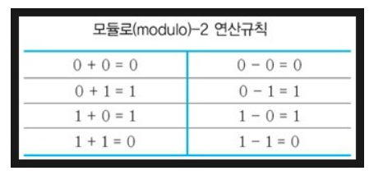
CRC(Cyclic Redundancy Check) : Determine whether the data transmitted by the sender is a normal signal.
The validity of the transmitted message is determined by the receiving node. For the mathematical operation method, modulo 2 is applied.
= XOR
CRC generator polynomial
binary : g(x) = 1100010110011001
ID |  |  |  |  |  |  |  |  |  |  | RTR | Control |  |  |  |  |  | Data |  |  |  |  |  |  |  | CRC
0 | 0 | 0 | 0 | 0 | 0 | 0 | 0 | 0 | 1 | 1 | 0 | 0 | 0 | 0 | 0 | 0 | 1 | 1 | 1 | 0 | 1 | 1 | 0 | 1 | 1 | 0 | 0 | 0 | 0 | 0 | 0 | 0 | 0 | 0 | 0 | 0 | 0 | 0 | 0 | 0
First, 15 zeros are added to the CRC part.
Notes:
CRC는 데이터가 정상 신호를 보냈는지 확인하는 역할을 합니다. CRC is to verify that the data has sent a normal signal.
전송된 메시지의 유효성은 수신 노드에 의해 결정됩니다. 수학적 연산방법은 모듈로 2가 적용된다.
The validity of the transmitted message is determined by the receiving node. For the mathematical operation method, modulo 2 is applied. 모듈로-2 연산은 XOR 연산과 비슷합니다.
The Modulo-2 operation is similar to the XOR operation.
CRC 계산을 위해서는 먼저 생성 다항식이라는 것이 필요합니다.
For CRC calculations, need something called a generative polynomial.

Slide 17

ID |  |  |  |  |  |  |  |  |  |  | RTR | Control |  |  |  |  |  | Data |  |  |  |  |  |  |  | CRC
0 | 0 | 0 | 0 | 0 | 0 | 0 | 0 | 0 | 1 | 1 | 0 | 0 | 0 | 0 | 0 | 0 | 1 | 1 | 1 | 0 | 1 | 1 | 0 | 1 | 1 | 0 | 0 | 0 | 0 | 0 | 0 | 0 | 0 | 0 | 0 | 0 | 0 | 0 | 0 | 0
1 | 1 | 0 | 0 | 0 | 1 | 0 | 1 | 1 | 0 | 0 | 1 | 1 | 0 | 0 | 1
remainder
1 | 0 | 1 | 0 | 1 | 1 | 1 | 0 | 1 | 0 | 0
Divide the generative polynomial again by adding the following expression
1 | 0 | 1 | 0 | 1 | 1 | 1 | 0 | 1 | 0 | 0 | 1 | 0 | 0 | 0 | 0
1 | 1 | 0 | 0 | 0 | 1 | 0 | 1 | 1 | 0 | 0 | 1 | 1 | 0 | 0 | 1
remainder
0 | 1 | 1 | 0 | 1 | 0 | 1 | 1 | 0 | 0 | 0 | 0 | 1 | 0 | 0 | 1
 | 1 | 1 | 0 | 1 | 0 | 1 | 1 | 0 | 0 | 0 | 0 | 1 | 0 | 0 | 1 | 0
1 | 1 | 0 | 0 | 0 | 1 | 0 | 1 | 1 | 0 | 0 | 1 | 1 | 0 | 0 | 1
 |  |  |  | 1 | 0 | 0 | 1 | 1 | 1 | 0 | 0 | 0 | 1 | 0 | 1 | 1
 |  |  |  | 1 | 0 | 0 | 1 | 1 | 1 | 0 | 0 | 0 | 1 | 0 | 1 | 0 | 0 | 0 | 0
Notes:
CRC 검사를 체크섬이라고도 불립니다.
CRC checks are also called checksums.
데이터 프레임에서 ID영역부터 계산에 사용합니다.
Use to calculate from the ID area in the data frame.
먼저 데이터가 첫 비트가 0이면 아무 연산도 하지 않고 다음으로 넘어갑니다. 즉, 데이터의 첫 비트가 1인 지점을 찾습니다.
First, if the first bit of the data is zero, it does nothing and goes on. That is, find the point where the first bit of the data is 1.
데이터가 1인 지점을 찾으면 그 곳에 생성 다항식을 XOR연산합니다.
If you find a point where the data is 1, XOR operations a generative polynomial there.
그리고 남은 나머지에다가 생성다항식에 XOR연산을 할수 있게 계산에 사용하지 않은 dataframe을 이어 붙입니다.
In addition to the remainder, connect the data frames that are not used in the calculation so that the generative polynomial can be XOR operations on the data frame.
이 부분에서는 CRC연산을 위해서 5개의 비트가 부족하니 5개의 비트를 이어 붙입니다.
In this part, 5 bits are missing for CRC operation, so 5 bits are connected.
이러한 계산을 계속 반복해 나갑니다.
keep repeating these calculations.

Slide 18
ID |  |  |  |  |  |  |  |  |  |  | RTR | Control |  |  |  |  |  | Data |  |  |  |  |  |  |  | CRC
0 | 0 | 0 | 0 | 0 | 0 | 0 | 0 | 0 | 1 | 1 | 0 | 0 | 0 | 0 | 0 | 0 | 1 | 1 | 1 | 0 | 1 | 1 | 0 | 1 | 1 | 0 | 0 | 0 | 0 | 0 | 0 | 0 | 0 | 0 | 0 | 0 | 0 | 0 | 0 | 0
 |  |  |  | 1 | 0 | 0 | 1 | 1 | 1 | 0 | 0 | 0 | 1 | 0 | 1 | 1 | 0 | 0 | 0
1 | 1 | 0 | 0 | 0 | 1 | 0 | 1 | 1 | 0 | 0 | 1 | 1 | 0 | 0 | 1
remainder
 |  |  |  |  | 1 | 0 | 1 | 1 | 0 | 0 | 1 | 1 | 1 | 0 | 0 | 0 | 0 | 0 | 1
 |  |  |  |  | 1 | 0 | 1 | 1 | 0 | 0 | 1 | 1 | 1 | 0 | 0 | 0 | 0 | 0 | 1 | 0
1 | 1 | 0 | 0 | 0 | 1 | 0 | 1 | 1 | 0 | 0 | 1 | 1 | 0 | 0 | 1
remainder
 |  |  |  |  |  | 1 | 1 | 1 | 0 | 1 | 1 | 0 | 0 | 0 | 0 | 1 | 1 | 0 | 1 | 1
 |  |  |  |  |  | 1 | 1 | 1 | 0 | 1 | 1 | 0 | 0 | 0 | 0 | 1 | 1 | 0 | 1 | 1 | 0
1 | 1 | 0 | 0 | 0 | 1 | 0 | 1 | 1 | 0 | 0 | 1 | 1 | 0 | 0 | 1
remainder
 |  |  |  |  |  |  |  | 1 | 0 | 1 | 0 | 0 | 1 | 1 | 0 | 1 | 0 | 1 | 1 | 1 | 1

Slide 19
ID |  |  |  |  |  |  |  |  |  |  | RTR | Control |  |  |  |  |  | Data |  |  |  |  |  |  |  | CRC
0 | 0 | 0 | 0 | 0 | 0 | 0 | 0 | 0 | 1 | 1 | 0 | 0 | 0 | 0 | 0 | 0 | 1 | 1 | 1 | 0 | 1 | 1 | 0 | 1 | 1 | 0 | 0 | 0 | 0 | 0 | 0 | 0 | 0 | 0 | 0 | 0 | 0 | 0 | 0 | 0
 |  |  |  |  |  |  |  | 1 | 0 | 1 | 0 | 0 | 1 | 1 | 0 | 1 | 0 | 1 | 1 | 1 | 1 | 0 | 0
1 | 1 | 0 | 0 | 0 | 1 | 0 | 1 | 1 | 0 | 0 | 1 | 1 | 0 | 0 | 1
remainder
 |  |  |  |  |  |  |  |  | 1 | 1 | 0 | 0 | 0 | 1 | 1 | 0 | 0 | 1 | 0 | 0 | 1 | 0 | 1
 |  |  |  |  |  |  |  |  | 1 | 1 | 0 | 0 | 0 | 1 | 1 | 0 | 0 | 1 | 0 | 0 | 1 | 0 | 1 | 0
1 | 1 | 0 | 0 | 0 | 1 | 0 | 1 | 1 | 0 | 0 | 1 | 1 | 0 | 0 | 1
Final generated remainder
 |  |  |  |  |  |  |  |  |  |  |  |  |  |  | 1 | 1 | 1 | 1 | 0 | 1 | 0 | 0 | 1 | 1
The calculation is repeated until all data before CRC are 0.
CRC sequence
0 | 0 | 0 | 1 | 1 | 1 | 1 | 0 | 1 | 0 | 0 | 1 | 1 | 0 | 0
Notes:
생성 다항식과의 XOR 연산을 마친 나머지가 Data frame의 Data field 영역의 위치인 부분을 모두 0으로 만들면, 연산을 종료합니다.
When the remainder of the XOR operation with the generative polynomial has zeroed all the parts of the Data field area of the Data frame.
그리고 그 나머지에 15자리가 되도록 0을 앞에 부분에 이어 붙인 것을 CRC sequence라고 합니다. At the last part, connect a zero to the front of the remainder.
When Remainder reaches 15 digits, it becomes CRC sequence.

Slide 20
ID |  |  |  |  |  |  |  |  |  |  | RTR | Control |  |  |  |  |  | Data |  |  |  |  |  |  |  | CRC
0 | 0 | 0 | 0 | 0 | 0 | 0 | 0 | 0 | 1 | 1 | 0 | 0 | 0 | 0 | 0 | 0 | 1 | 1 | 1 | 0 | 1 | 1 | 0 | 1 | 1 | 0 | 0 | 0 | 1 | 1 | 1 | 1 | 0 | 1 | 0 | 0 | 1 | 1 | 0 | 0
1 | 1 | 0 | 0 | 0 | 1 | 0 | 1 | 1 | 0 | 0 | 1 | 1 | 0 | 0 | 1
remainder
1 | 0 | 1 | 0 | 1 | 1 | 1 | 0 | 1 | 0 | 0
Divide the generative polynomial again by adding the following expression
1 | 0 | 1 | 0 | 1 | 1 | 1 | 0 | 1 | 0 | 0 | 1 | 0 | 0 | 0 | 1
1 | 1 | 0 | 0 | 0 | 1 | 0 | 1 | 1 | 0 | 0 | 1 | 1 | 0 | 0 | 1
The calculation is repeated until all data before CRC are 0.
If the generated remainder becomes 0, it is judged as a normal message!
Notes:
생성 다항식의 자리에 생성된 CRC sequence를 넣고 다시 연산을 수행합니다.
Place the generated CRC sequence in the place of the generative polynomial and perform the operation again.
그래서 최종적인 나머지가 모두 0을 띄면 정상적인 메시지라고 판단을 하게 됩니다.
So if the final remainder is all zero, we're going to assume that it's a normal message.

Slide 21
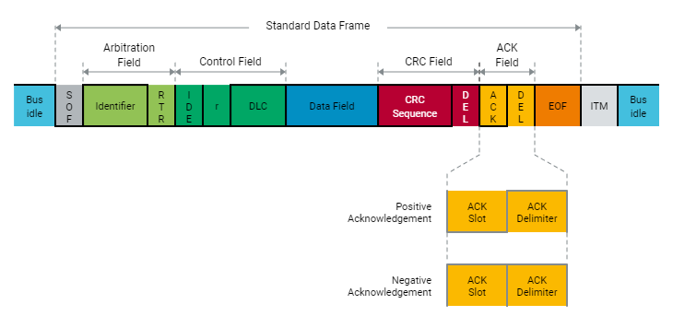
ACK: The ACK field consists of an Ack slot and an ACK Delimiter.
ACK is an acknowledgment by receiving a message, and the receiving node, not the sending node, responds.
When verified through CRC, if there is no abnormality, a dominant (0) bit is added to the ACK field, and if not, a recessive (1) bit is added. That is, if it is received normally, it becomes '01', but if it is not, it becomes '11'.
Notes:
ACK 필드는 ACK 슬롯과 ACK 구분자로 구성됩니다.
The ACK field consists of an Ack slot and an ACK Delimiter.
ACK는 메시지를 수신함으로써 확인 응답을 하는 것이며, 수신 노드가 응답합니다.
ACK is an acknowledgment by receiving a message, and the receiving node responds., not the sending node.
CRC를 통해 검증했을 때 이상이 없으면 ACK 필드에 우성(0) 비트가 추가되고, 없으면 열성(1) 비트가 추가된다. 즉, 정상적으로 수신되면 '01'이 되고, 수신되지 않으면 '11'이 됩니다.
When verified through CRC, if there is no abnormality, a dominant (0) bit is added to the ACK field, and if not, a recessive (1) bit is added. That is, if it is received normally, it becomes '01', but if it is not, it becomes '11'.

Slide 22
8. Principle of Bus Access
Each node in the CAN network can access the CAN bus without permission or prior coordination with other CAN nodes.
However, there is a risk that multiple CAN nodes access the CAN bus at the same time, causing duplication of the CAN bus
To prevent this, a method called CSMA/CA (Carrier Sence Multiple Access with Collision Avoidance) is used. A CAN node that wants to originate through the CSMA/CA method can access the CAN bus at an appropriate time.
For CAN bus access, the CSMA/CA method based on bit bus arbitration (which uses ID to prioritize messages) selects the highest priority CAN message among CAN nodes.
Notes:
CAN 네트워크의 각 노드는 허가 없이 또는 다른 CAN 노드와의 사전 조정 없이 CAN 버스에 액세스할 수 있습니다.
Each node in the CAN network can access the CAN bus without permission or prior coordination with other CAN nodes.
그러나 여러 개의 CAN 노드가 동시에 CAN 버스에 액세스하여 CAN 버스가 중복될 위험이 있습니다.
However, there is a risk that multiple CAN nodes access the CAN bus at the same time, causing duplication of the CAN bus
이를 방지하기 위해 CSMA/CA(Carrier Sence Multiple Access with Collision Prevention)라는 방법이 사용된다. CSMA/CA 방법을 통해 시작하려는 CAN 노드는 적절한 시간에 CAN 버스에 액세스할 수 있습니다.
To prevent this, a method called CSMA/CA (Carrier Sence Multiple Access with Collision Avoidance) is used. A CAN node that wants to originate through the CSMA/CA method can access the CAN bus at an appropriate time.
CAN 버스 액세스의 경우, 비트 버스 조정(ID를 사용하여 메시지의 우선 순위를 지정하는)에 기반한 CSMA/CA 방법은 CAN 노드 중에서 가장 높은 우선 순위 CAN 메시지를 선택합니다.
For CAN bus access, the CSMA/CA method based on bit bus arbitration (which uses ID to prioritize messages) selects the highest priority CAN message among CAN nodes.

Slide 23
1. CAN Node A wishes to access the CAN bus
>> CAN node A cannot access the CAN bus until it is available, This occurs after the ITM expires. so, CAN node A monitors the CAN bus(Carrier Scence) to detect this.
2. CAN Node B wishes to access the CAN bus
>> CAN node B cannot access the CAN bus until it is available.
3. After the ITM expires, the CAN bus is idle. CAN node A and B may now access the CAN bus. CAN message A will be transmitted, because it has a higher priority compared to CAN message B.
>> CAN node B waits until the CAN bus is available again.
4. CAN node B accesses the CAN bus and transmits its CAN message.
1
3
CAN Node A
(High Priority)
Carrier Scence
CAN Frame
ITM
CAN Frame A
ITM
CAN Frame B
ITM
CAN Bus
Carrier Scence
CAN Node B
(Low Priority)
2
4
ITM : intermission
Notes:
1. CAN Node A wishes to access the CAN bus
>> CAN node A cannot access the CAN bus until it is available, This occurs after the ITM expires. so, CAN node A monitors the CAN bus to detect this. it means carrier scence.
2. CAN Node B wishes to access the CAN bus
>> CAN node B cannot access the CAN bus until it is available.
3. After the ITM expires, the CAN bus is idle. CAN node A and B may now access the CAN bus. CAN message A will be transmitted, because it has a higher priority compared to CAN message B.
>> CAN node B waits until the CAN bus is available again.
4. CAN node B accesses the CAN bus and transmits its CAN message.

Slide 24
9. Bit Stuffing
1bit
7bit
3bit
If it is a normal signal, 11 recessive signals will come to the corresponding location.
When 11 recessive signals come
Determining that the bus is in Idle state.
When there are 11 recessive signals in ID or Data Field, it can be recognized that the bus is in Idle state!
Notes:
정상적인 신호라면 데이터 프레임의 끝 부분에 11개의 열성 비트가 연속적으로 나타나게 됩니다.
A normal signal would result in 11 consecutive recessive bits at the end of the data frame.
그래서 11개의 열성비트가 연속적으로 나타나면 CAN bus가 idle한 상태에 있다고 인식하게 되죠.
So when 11 recessive bits appear in a row, CAN node realize that the CAN bus is in an idle.
하지만 상대적으로 길이가 긴 ID field나 Data Field에서 11개의 열성 비트가 발생하게 되면 CAN bus가 Idle하다고 인식할 수 있습니다. However, if 11 recessive bits occur in a relatively long ID field or Data field, the CAN bus may be recognized as Idle.

Slide 25
Bit stuff: Extra bits created when 5 consecutive occurrences of the same data occur
CAN nodes not only can determine that the other side's transmission is wrong, but also diagnose themselves and decide whether to leave the bus. Therefore, when six or more dominant or recessive signals are transmitted, it is determined that there is an abnormality.
1 | 2 | 3 | 4 | 5 | 6 | 7 | 8 | 9 | 10 | 11 | 12 | 13 | 14 | 15
signal to send
1 | 2 | 3 | 4 | 5 | S | 6 | 7 | 8 | 9 | 10 | 11 | 12 | 13 | 14
signal with bit stuff applied
This signal will be ignored!
Notes:
그래서 5개의 연속적인 비트가 나타나게 되면 비트 스터프를 발생시킵니다.
So when five consecutive bits appear, it generates a bitstuff.
CAN 노드는 상대방의 dataframe이 잘못됐음을 판단할 수 있을 뿐 아니라 스스로 진단해 버스를 떠날지 여부를 결정할 수 있다. 따라서 6개 이상의 우성 또는 열성 신호가 전달되면 이상이 있는 것으로 판단된다.
CAN nodes not only can determine that the other side＇s dataframe is wrong, but also diagnose themselves and decide whether to leave the bus. Therefore, when six or more dominant or recessive signals are transmitted, it is determined that there is an abnormality.
5개 이상의 연속적인 신호를 보내려면 중간에 bit stuff가 발생하며, bit stuff는 신호를 해석할때 무시됩니다.
To send more than five consecutive signals, bitstuff occurs, which is ignored when interpreting the signal.

Slide 26

10. CAN DBC
CAN dbc used in CAN communication.
From the signal used for communication, all information about each node is described.
Interpret binary signals as meaningful signals.
1000110
1100010
1010111
Steer : 232
RPM : 600
Speed : 23.4
CAN dbc
Notes:
CAN dbc는 database로 이진 신호를 의미 있는 신호로 변환하기 위해서 사용됩니다.
Candbc is used to convert binary signals into meaningful signals.

Slide 27
CAN dbc
0x12345678
(32bits)
Channel name
location of start bit, length of bit
Default value
Explain
Byte order(Big Endian, Little Endian)
Data type(Signed, Unsigned)
Scaling & Units
Max, Min rage
Low
memory
1byte
(8bits)
0x12
0x78
1byte
(8bits)
0x34
0x56
1byte
(8bits)
0x56
0x34
1byte
(8bits)
0x78
0x12
Big Endian
Little Endian
High
memory
Notes:
Candbc includes location of start bit, length of bit, default value, explain, byte order, data type, scaling and units, min max range.
여기서 byte order는 big endian과 little endian으로 나뉩니다.
big endian는 motolooa에서 이용되고 little endian은 intel에서 주로 사용합니다.
big endian는 데이터를 순서에 맞게 저장하나, little endian은 데이터를 역순으로 저장합니다.
Here, the byte order is divided into big endian and little endian. Big endian is used by motorola and little endian is used mainly by intel. Big endian stores data in order, but little endian stores data in reverse order.
빅 엔디안은 사람이 숫자를 나열하는 방식과 비슷하여 디버깅에 편리합니다. The Big Endian is convenient for debugging because it is similar to the way people list numbers.
리플 엔디안은 연산을 수행할때 더 편리합니다.
Little Endians are more convenient when performing operations.

Slide 28
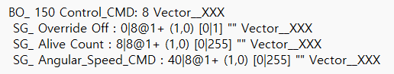
1
2
3
4
5
6
7
8
9
10
11
12
13
Message Syntax
CAN ID (Hexademical)
Name
Length(Byte)
name of Transmitting node, Vector_XXX means no name
Signal Syntax
7. Name
8. bit start, length
9. 0 = Big Endian 1 = Little Endian
10.+ unSigned, - signed
11. Scale, offset(real value = raw value*1 + 0(offset)
12. min, max
13. receiving node name
Notes:
DBC 파일의 예시입니다.
각 요소에 대한 내용은 다음과 같습니다. An example of a DBC file. Each element is described below.

Slide 29
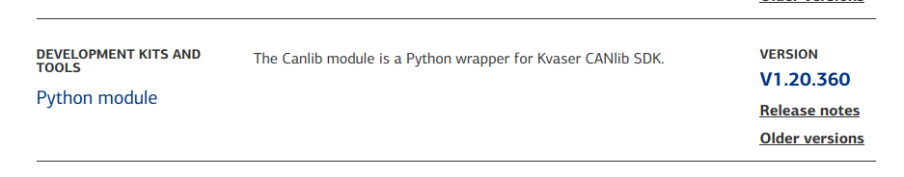
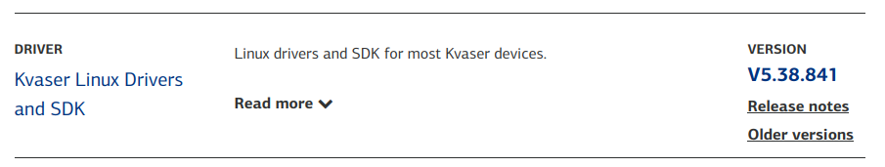
10. CAN DBC (Environment setting)
The environment setting is carried out in the initial installation state of Ubuntu 18.04.
sudo apt-get update
sudo apt install python3-pip
pip3 install canlib
https://www.kvaser.com/downloads-kvaser/
download pycanlib.zip
unzip pycanlib.zip
cd pycanlib
pip3 install canlib-1.20.360-py3-none-any.whl
downloads linuxcan.tar.gz
tar -xzvf linuxcan.tar.gz
cd linuxcan

Slide 30
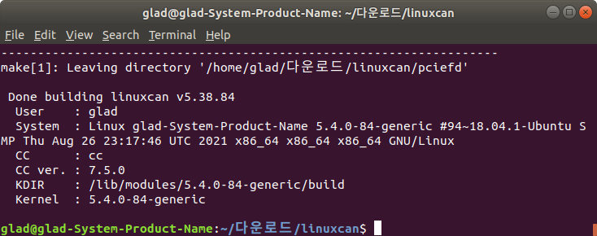
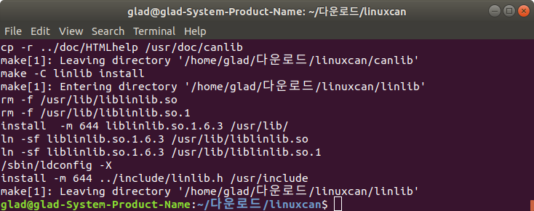

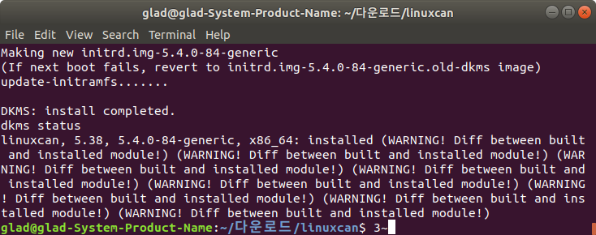
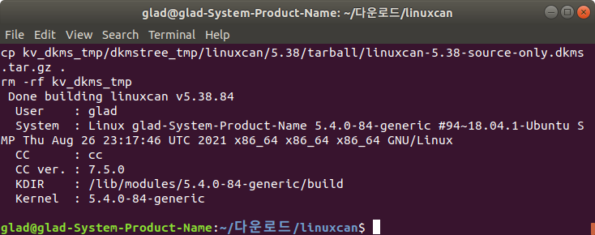
sudo apt-get install build-essential
sudo apt-get install linux-headers-`uname –r`
sudo apt-get install dkms
make
sudo make install
sudo make load
make dkms
sudo make dkms_install

Slide 31
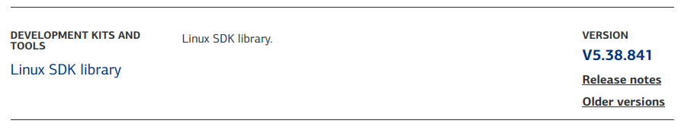
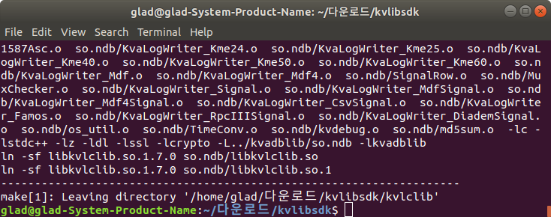
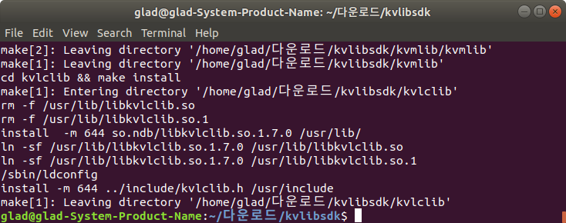
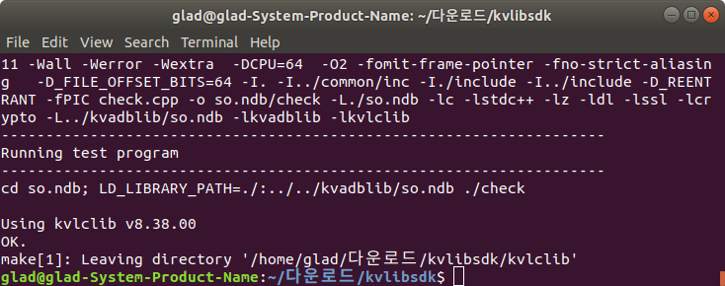
download kvlibsdk.tar.gz
cd ..
tar -xzvf kvlibsdk.tar.gz
cd kvlibsdk
sudo apt install libxml2-dev
sudo apt install libssl-dev
sudo apt install zlib1g-dev
make
make check
sudo make install

Slide 32
python3 CAN_create_dbc_class.py
Save root
Environment setting have been confirmed to work in initial Ubuntu 18.04 (re-installed)!

Slide 33

10. CAN DBC (Install vscode)
Install vscode
https://code.visualstuido.com
Downloads .deb file
Sudo dpkg -i code_~
Code >> vscode run
Notes:
vscode를 꼭 쓰실 필요는 없고 자신이 편한 IDE환경을 사용하시면 됩니다.
You don't have to use the vscode, you can use the IDE that you feel comfortable.

Slide 34
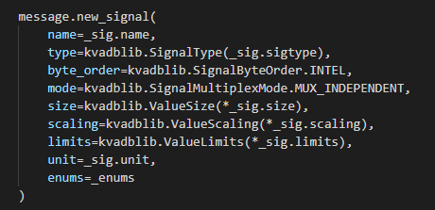
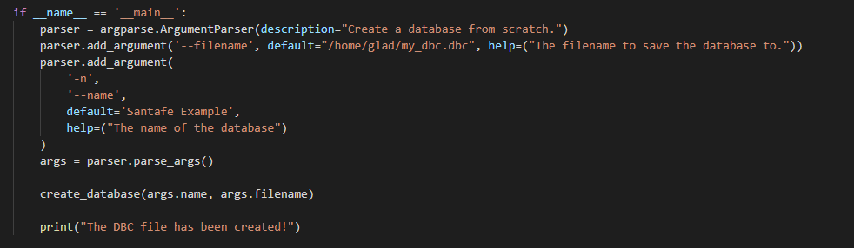
10. CAN DBC (Create DBC file)
Download the lecture materials
Note. CAN_create_dbc_for_class.py
canlib.kavadlib.signalbyteorder
INTEL = 0 (Little Endian)
MOTOROLA = 1 (Big Endian)
canlib.kavdlib.SignalType(value)
DOUBLE = 4
ENUM_SIGNED = 101
ENUM_UNSIGNED = 102
FLOAT = 3
INVALID = 0
SIGNED = 1
UNSIGNED = 2
canlib.ValueSize(startbit, length)
canlib.ValueScaling(factor, offset)
canlib.ValueLimits(min,max)
Save root
Notes:
이 부분에서는 강의자료에 올려둔 python 파일을 참고하셔서 진행하시면 됩니다.
save root를 잘 지정해 주세요.
For this part, you can refer to the python file on the lecture material.
Please specify the save root well.

Slide 35
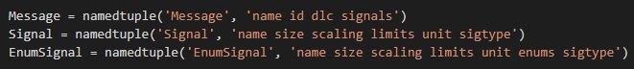
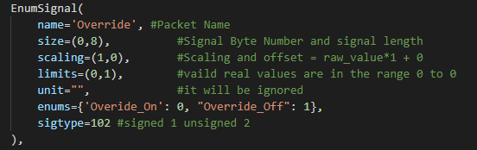
Notes:
샘플 코드는 namedtuple이 사용됩니다.
각 namedtuple의 모든 요소가 사용되어야만 오류가 일어나지 않습니다.
The sample code use namedtuple. All elements of each namedtuple must be used to avoid errors.

Slide 36
HW 4-1
due : 5/16 10PM
Complete the DBC file generation code by referring to the datasheet.xlsx file. (Complete the CAN_create_dbc_class.py)
1-1) Don’t use ‘spacebar’,’-’ at name at EnumSignal, Signal, Message name! It occurs error.
1-2)you don’t need to create the red part of the datasheet.
1-3)uint8 means Unsigned int, Gain means Scaling.
1-4)You don't have to create a new code, you can modify the sample code!
2. Submit the DBC file generated by the DBC file generation code.
(ex. HW4_20211073_hwanginwoo.py, HW4_20211073_hwanginwoo.dbc)
send to hwanginwoo@gm.gist.ac.kr
Notes:
샘플 코드에서는 Control_CMD 부분만 구현되어 있습니다.
Driving CMD, Vehicle information 1,2,3,4를 완성시키세요.
이렇게 해서 만든 코드와 DBC파일을 저에게 제출하시면 됩니다.
Only the Control_CMD portion is implemented in the sample code. Complete Driving CMD, Vehicle information 1, 2, 3, and 4. You have to submit the code and DBC file to me

Slide 37
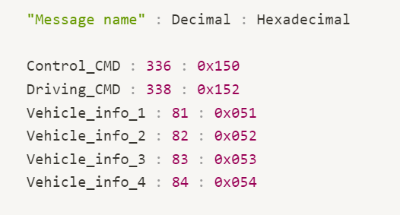
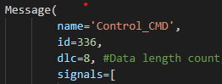
Only Control_CMD is implemented in sample code!
Implement Driving_CMD, Vehicle info.1, 2, 3, and 4!
Don't confuse Decimal and Hexadecimal!

